Slide 1




LIRI Bot – Command Line Interface - functionality
User has 4 choices:
concert-this
spotify-this-song
movie-this
do-what-it-says
When user selects the option “do-what-it-says”, the program will read the command from the file “random.txt” and will perform the command accordingly. That command falls in one of the other choices listed above.
For other user choices, respective functions will be called to retrieve the relevant information for corresponding APIs.
User choices
do-what-it-says
concert-this
spotify-this-song
movie-this
random.txt
LIRI Bot
(liri.js)
do-what-it-says
concert-this
spotify-this-song
movie-this
concert ()
spotify_this ()
movie_this ()

Slide 2
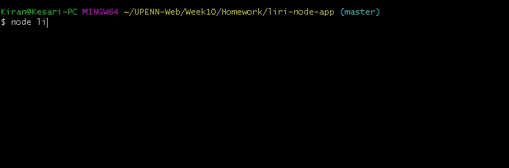
LIRI Bot – Command Line Interface - functionality
liri.js concert-this
When user selects option:
concert-this
If user does not provide any artist name or band name, the program prompts to provide an artist name, displaying a message on screen.
When user provides a valid artist name, the program displays venue and date of the event.

Slide 3
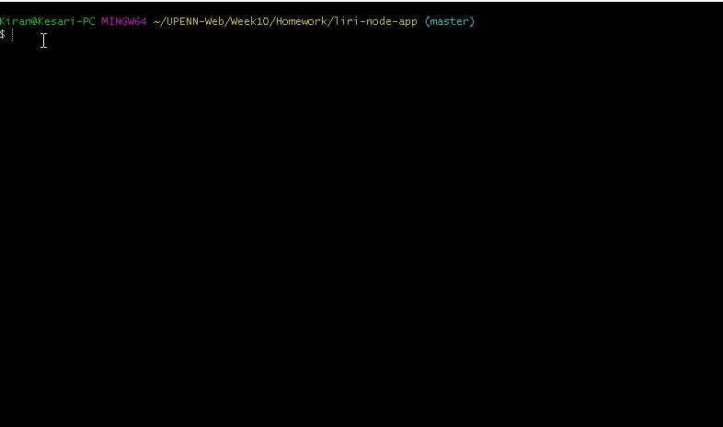
LIRI Bot – Command Line Interface - functionality
liri.js spotify-this-song
When user selects option:
spotify-this-song
If user does not provide any song name, the program shows a defaulted song “Sign of the times”.
When user provides a valid song name, the program displays
artist name,
song name,
preview link
album name
details of the provided song.

Slide 4
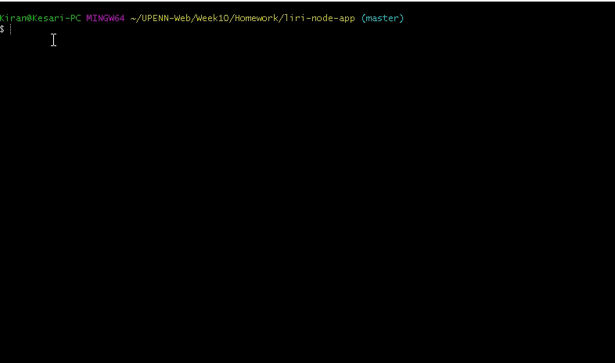
LIRI Bot – Command Line Interface - functionality
liri.js movie-this
When user selects option:
movie-this
If user does not provide any movie name, the program displays the defaulted movie name “Mr. Nobody”.
When user provides a valid movie name, the program displays the below movie information:
Title
Release Year
Rotten Tomatoes rating
Country
Language
Plot
Actors

Slide 5
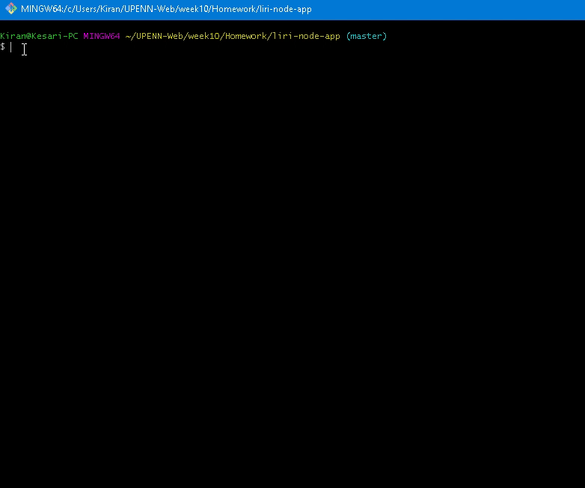
LIRI Bot – Command Line Interface - functionality
liri.js do-what-it-says
When user selects option:
do-what-it-says
This option reads the command provided in the random.txt file located in the same directory and executes the command.
The random.txt is a comma separated text with what action to perform and respective inputs for that action.

